Slide 1
Pelvic wall
BY: M. G. HAMMAD

Slide 2
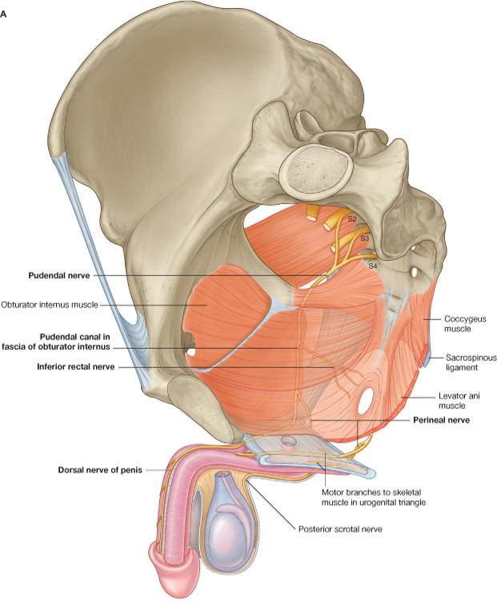
STRUCTURE OF THE PELVIC WALLS
Formed by bones and ligaments.
Which partly lined with muscles.
Covered with fascia and parietal peritoneum.
It has:
Anterior wall.
Lateral wall.
Posterior wall.
Inferior wall {pelvic floor}.

Slide 3
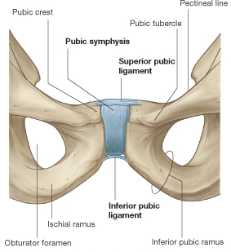
Anterior Wall
Formed by:
Posterior surfaces of the bodies of the pubic bones.
Pubic rami.
Symphysis pubis.

Slide 4
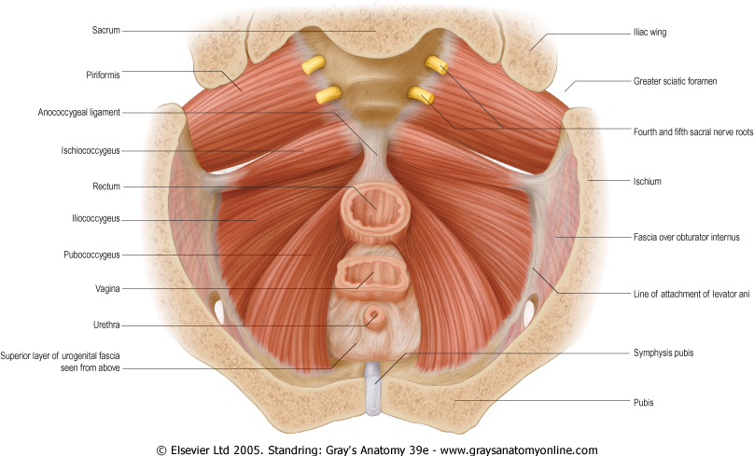
Posterior Wall
Extensive wall.
Formed by:
Sacrum and coccyx.
Piriformis muscles with their covering of parietal pelvic fascia.

Slide 5
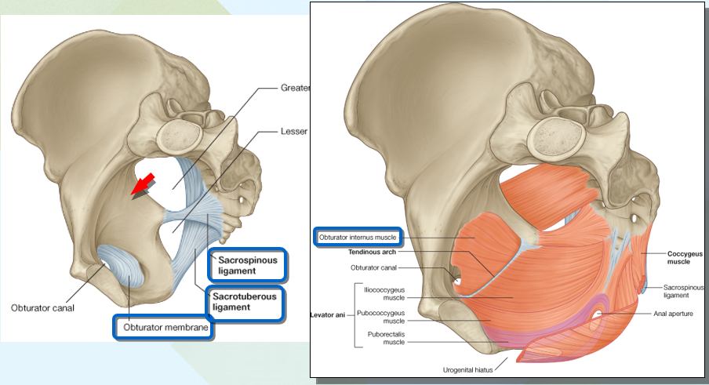
Lateral Wall
Formed by:
Part of the hip bone below the pelvic inlet.
Obturator membrane.
Sacro tuberous and sacrospinous ligaments.
Obturator internus muscle and its covering fascia.

Slide 6
Inferior Wall {Floor}
Formed by:
Pelvic diaphragm:
Stretches across pelvis and divides it into:
Main pelvic cavity above.
Perineum below.

Slide 7
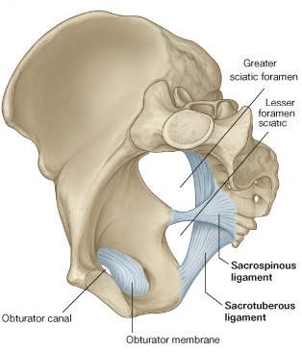
Pelvic Membranes & Ligaments
Obturator Membrane:
It is a fibrous sheet.
Completely closes obturator foramen.
Leaving a small gap {obturator canal}.
The canal for passage of obturator nerve and vessels.

Slide 8
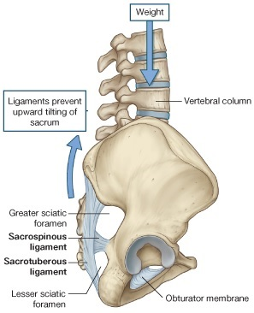
Pelvic Membranes & Ligaments
Sacrotuberous ligament:
It is strong ligament.
Extends from lateral part of sacrum & coccyx & posterior inferior iliac spine to ischial tuberosity.

Slide 9
Pelvic Membranes & Ligaments
Sacrospinous ligament:
It is strong and triangular.
It is attached by its base to lateral part of sacrum and coccyx and by its apex to spine of ischium.

Slide 10
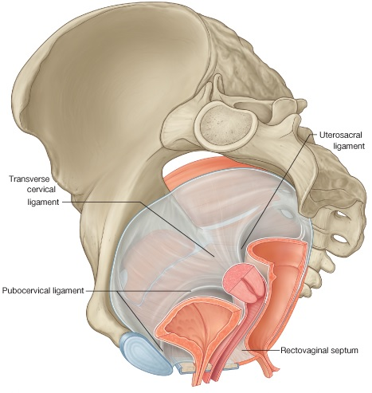
Pelvic Fascia
It is formed of connective tissue.
It continuous:
Above: with fascia lining abdominal walls.
Below: with fascia of perineum.
It can be divided into parietal and visceral layers.

Slide 11
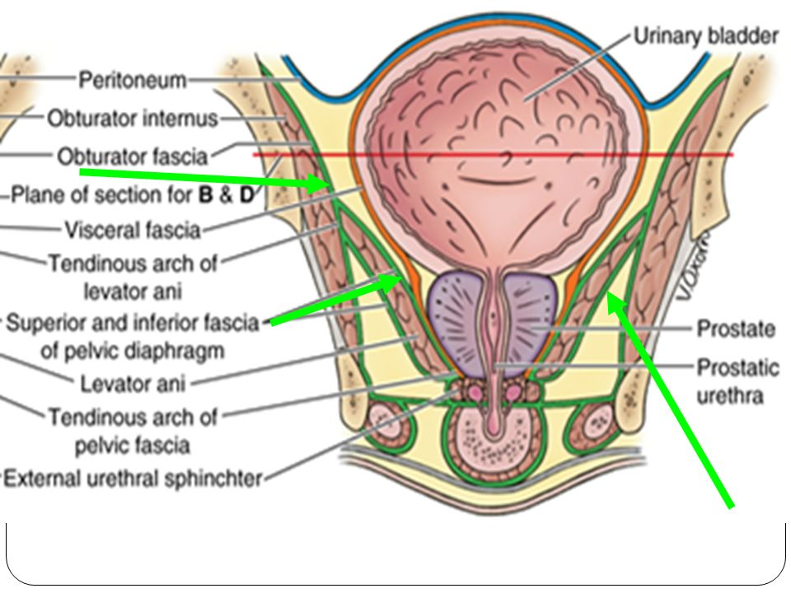
Parietal Pelvic Fascia
Lines walls of pelvis.
Named according to muscle it overlies.

Slide 12
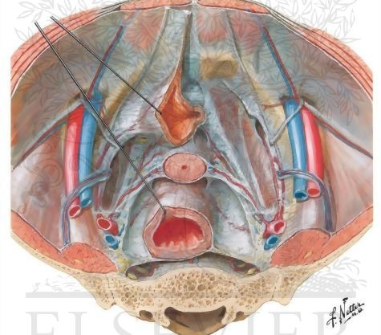
Visceral Pelvic Fascia
It covers and supports all pelvic viscera.
In certain locations fascia thickens and extends from viscus to pelvic walls and provides support.
These fascial ligaments are named according to their attachments, for example, pubovesical and sacrocervical ligaments.

Slide 13
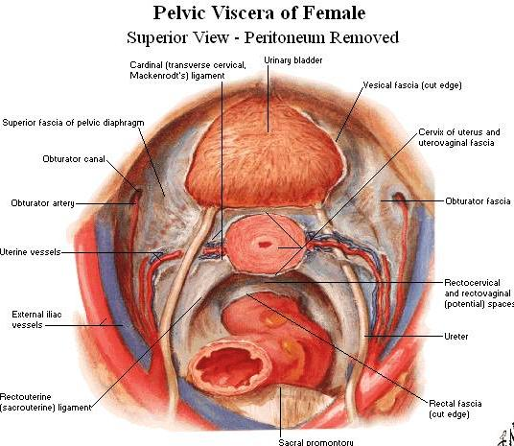
Pelvic Fascia

Slide 14
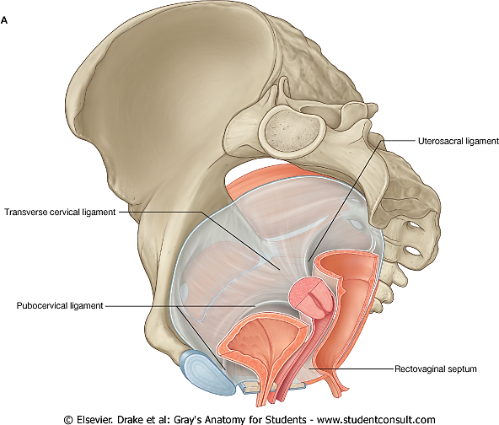
Female:
Rectovaginal septum:
Separates the posterior surface of the vagina from the rectum.
Condensations of fascia form ligaments that extend from the cervix:
Pubocervical ligament.
Transverse cervical or (cardinal ligament).
Uterosacral ligament.

Slide 15
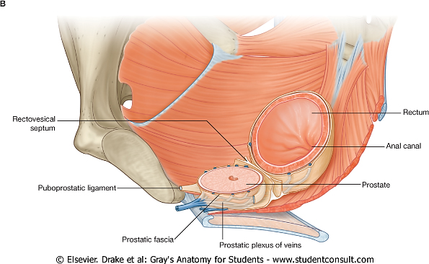
Male:
Condensation of fascia around the anterior and lateral region of the prostate (prostatic fascia).
Rectovesical septum:
Which separates the posterior surface of the prostate and base of the bladder from the rectum.

Slide 16
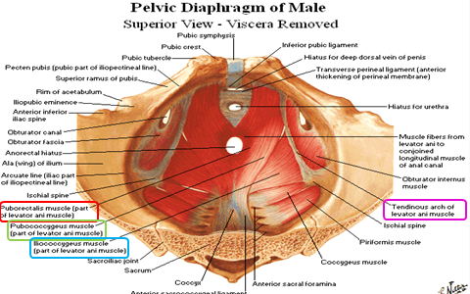
Pelvic Diaphragm (muscles of Pelvic floor)
Formed by 2 muscles & their covering fascia:
Levator Ani muscle.
Coccygeus muscle.

Slide 17
Levator Ani Muscle
Formed of 3 parts:
Pubococcygeus.
Puborectalis.
Iliococcygeus.
Origin:
Collectively they run from:
Body of the pubis.
Tendinous arch of the obturator fascia.
Ischial spine.

Slide 18
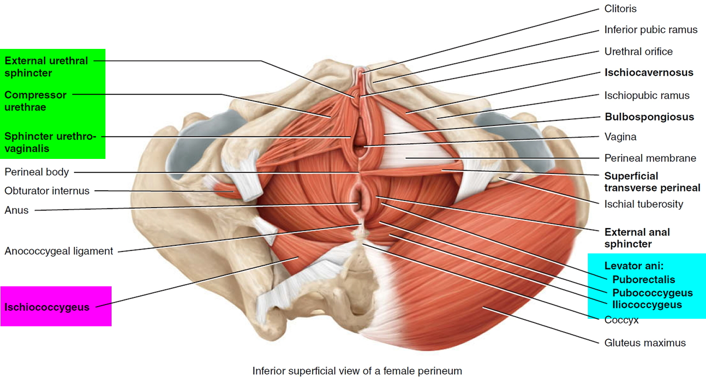
Levator Ani Muscle
Insertion:
To:
Perineal body.
The coccyx.
The anococcygeal ligament.
The walls of the prostate or vagina, the rectum and the anal canal.

Slide 19
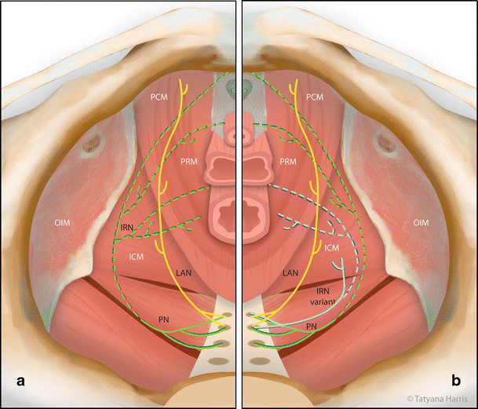
Levator Ani Muscle
Nerve Supply:
By:
Nerve to levator ani (S4).
Pudendal nerve.

Slide 20
Levator Ani Muscle
Action:
Forms most of the pelvic diaphragm that helps to support the pelvic viscera.
Acting together they raise the pelvic floor.
Assist the abdominal muscles in forced expiration activities.
They also have an important sphincter action on the anorectal junction, and in the female they serve also as a sphincter of the vagina.

Slide 21
Levator Ani Muscle
Specification:
Anterior fibers:
Levator prostate or sphincter vaginae form a sling around prostate or vagina and are inserted into perineal body, in front of anal canal.
Levator prostate support prostate and stabilize perineal body.
Sphincter vaginae constrict vagina and stabilize perineal body.
Intermediate fibers:
Puborectalis forms a sling around junction of rectum and anal canal.
Pubococcygeus passes posteriorly to insert into anococcygeal body.
Posterior fibers:
Iliococcygeus is inserted into anococcygeal body and coccyx.

Slide 22
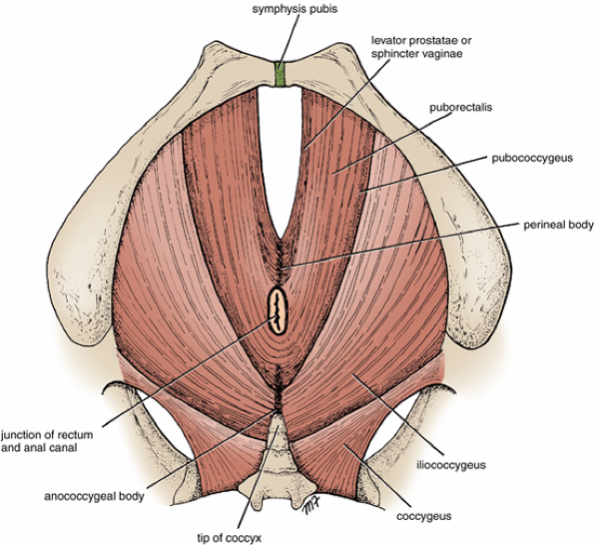
Coccygeus Muscle
Origin:
Ischial spine.
Insertion:
Lower end of the sacrum and coccyx.
Nerve supply:
Branches of S4 and S5.
Action:
Forms a small part of the pelvic diaphragm that supports the pelvic viscera.
Flexes the coccyx.

Slide 23
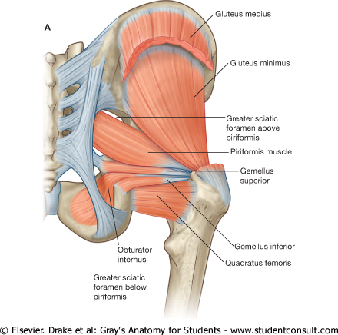
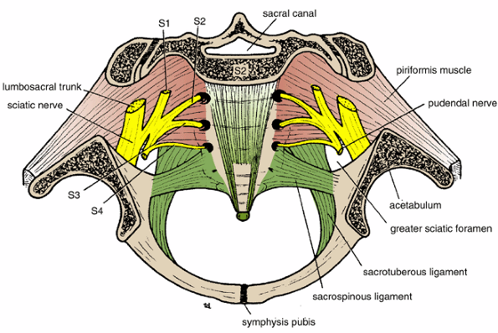
Muscles of Posterior Pelvic Wall {PIRIFORMIS}
Origin:
From the front of the lateral masses of the sacrum.
Insertion:
Into the upper border of the greater trochanter of the femur.
Nerve supply:
Branches sacral plexus.
Action:
Lateral rotation of femur at hip joint

Slide 24
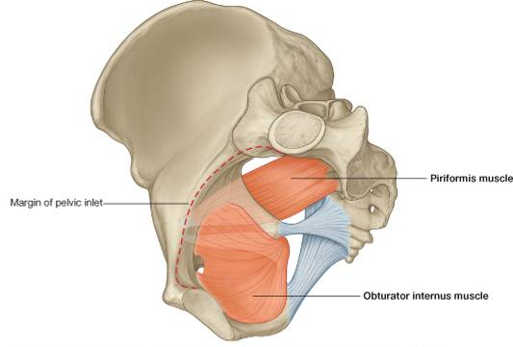
Muscles of Lateral Pelvic Wall {OBTURATOR INTERNUS}
Origin:
From pelvic surface of obturator membrane & adjoining part of hip.
Insertion:
Into greater trochanter of the femur.
Nerve supply:
Branches sacral plexus (nerve to obturator internus).
Action:
Lateral rotation of femur at hip joint

Slide 25
To be continue…

